Slide 1
Project 4
Algorithm Implementation
OCR Error Detection and Error Correction
Group7
Notes:
Chow tzie
Mingyu
Gabriel

Slide 2
Introduction
Error detection - Paper D2
Letter N-gram
Riseman, E. M., & Hanson, A. R. (1974). A contextual postprocessing system for error correction using binary n-grams. IEEE Transactions on Computers, 100(5), 480-493.
Error correction - Paper C5
Topic Models
M., Ross, M., & Learned-Miller, E. (2007, September). Context-sensitive error correction: Using topic models to improve OCR. In Document Analysis and Recognition, 2007. ICDAR 2007. Ninth International Conference on (Vol. 2, pp. 1168-1172). IEEE.

Slide 3
Error Detection - Letter N-gram
Digrams
Dictionary
Digrams
Ground Truth
Word Table
(Position)
Tesseract
Detect
OCR Words List
With Position
OCR
Words List
Notes:
Start with ground truth: a list of words that are correct ...we take that list of words and create a dictionary
Look at tesseract, list of words that has mistakes in it and take 80% of the data to train and we create an OCR words list
Both the dictionary and the OCR words list will be run through a function called Word Table that basically outputs a table with the words with their line position and what document they are in.
We then use the digrams function , which I will explain soon, to create digrams, which are matrices that display combinations of letters
WE then combine these matrices (digrams) and the list of OCR words with their positions in the detect algorithm, which I will also go over.
Circle → function
Table → dataset
Dictionary: list of all words
Word table: table with positioning of each word (line, and doc) which creates: OCR WORDS LIST with position
Digrams : 36 by 36

Slide 4
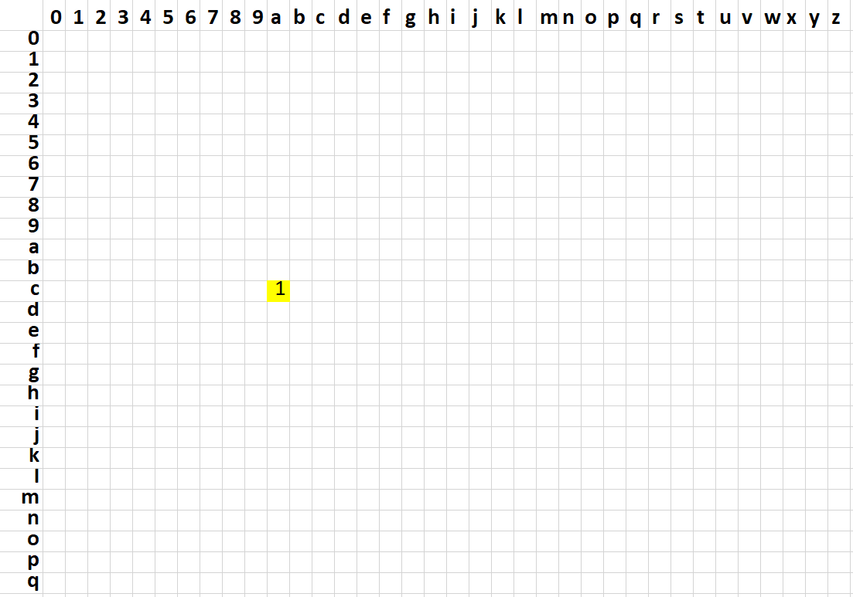
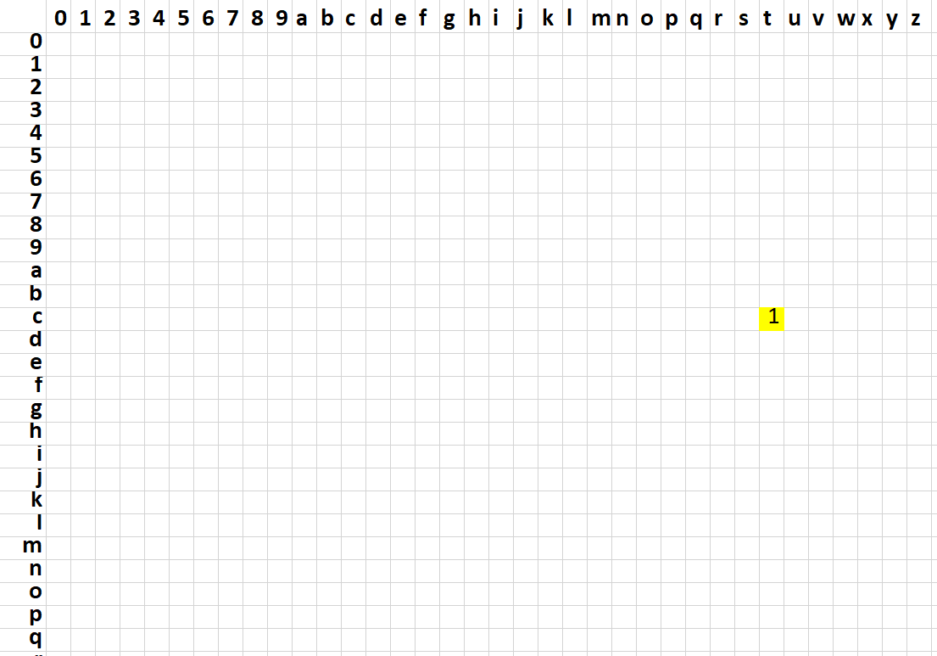
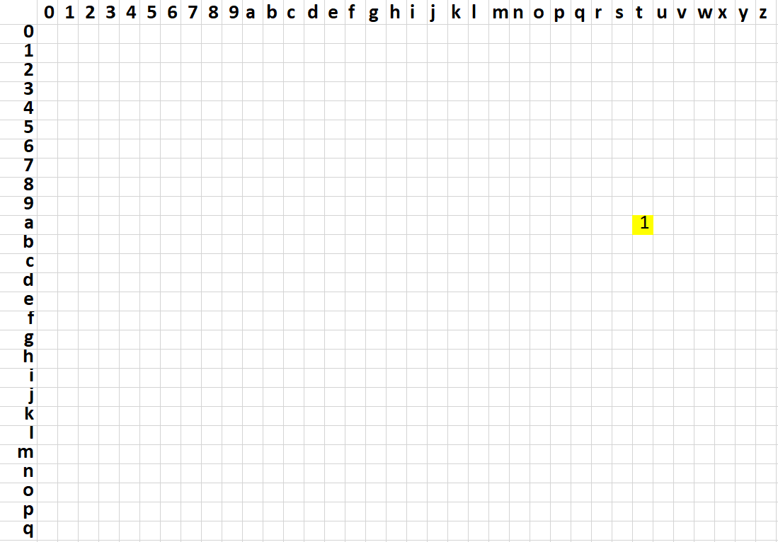
Positional Binary Digrams
Structure of Digram
Array with [ N, ((N-1)*N/2, 36, 36 ], where
N = #letter in a word
36 = 0-9 numbers + a-z letters
Notation
We use dictionary of ground truth to create digrams
And we use all documents in ground truth to
create the dictionary
cat
c
a
t
N=3
combinations=3
Digram = [3, 3,36,36]
Notes:
Digram [ n, n(n-1)/2 , 36, 36]
which is an improvement BTW because we noticed i = 1
A digram is a 4 dimensional array that holds
1) the number of characters in a word,
2) the possible combinations of pairs formed from this word
3) a 36 by 36 array containing all 9 numbers and all letters
Here is an example with the word CAT with a digram showing that at each combination, we put a 1
It's also important to note that there are some undetectable errors like
SUT (original) because all combinations exist (UT, SU, ST)
examples of why it's possible
CUT
SUN
SAT

Slide 5
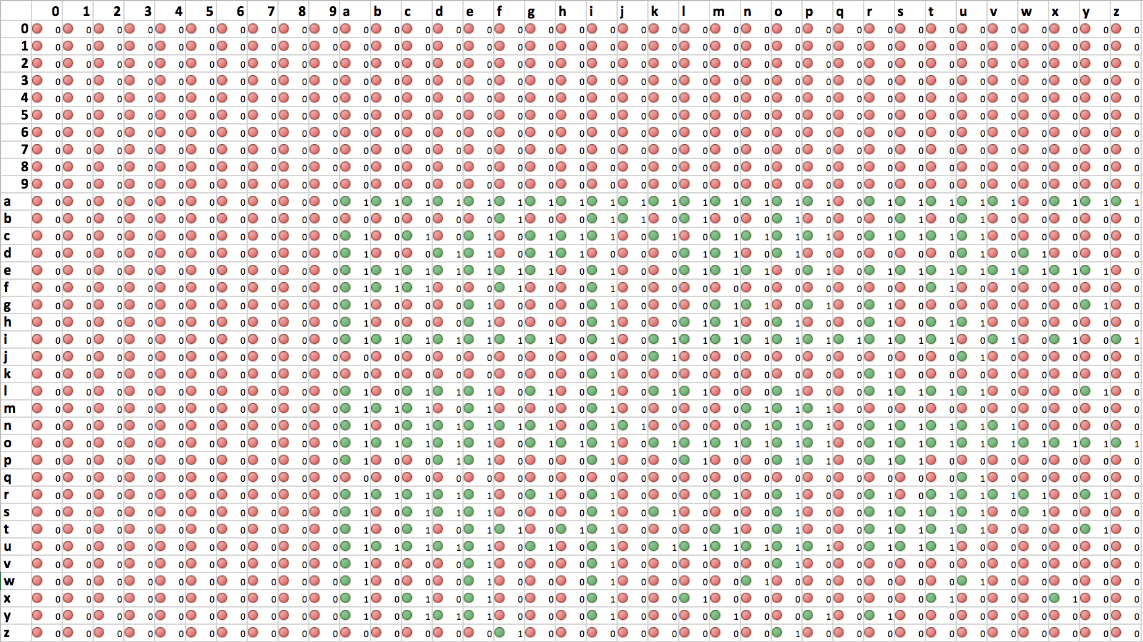
Positional Binary Digrams - Example
Words: length = 5
Combination = 5th
Notes:
Here is an example that gives a bigger overview of these combinations existing
We Looked at words of length 5, which gives us 4*5 = 20/ 2 = 10 combinations
This is a matrix that shows the existence of these combinations for all words of length 5 that occur at position 5
for example, the combination ab exists as a 5th combination for words that are positioned at 5

Slide 6
Detect
Detect
As
ERROR
[n,n(n-1)/2,i,j] == 0
Digrams
Position in Digrams
Match
the Position
Label the word with 1
Transform
[n,n(n-1)/2,i,j] == 1
All combinations of Letter
Word List
OCR Train with position
Notations
We only detect words with length 2 to 24
We do not detect words that contain only numbers
Notes:
First, it should be noted that:
we only detect words with length 2 to 24
we do not detect words that contain only numbers
Start with wordlist OCR train with each positions
We get all combinations of each letter
Position for each combination of letter
Match these positions with your digrams (which is trained from ground truth data)
If the position of the combination does not exist, it will output a 0 and it will be detected as a zero
And it will not if the combination does exist

Slide 7


“A major problem with a global language model is its inability to adapt to the idiosyncrasies of particular domains”

Slide 8
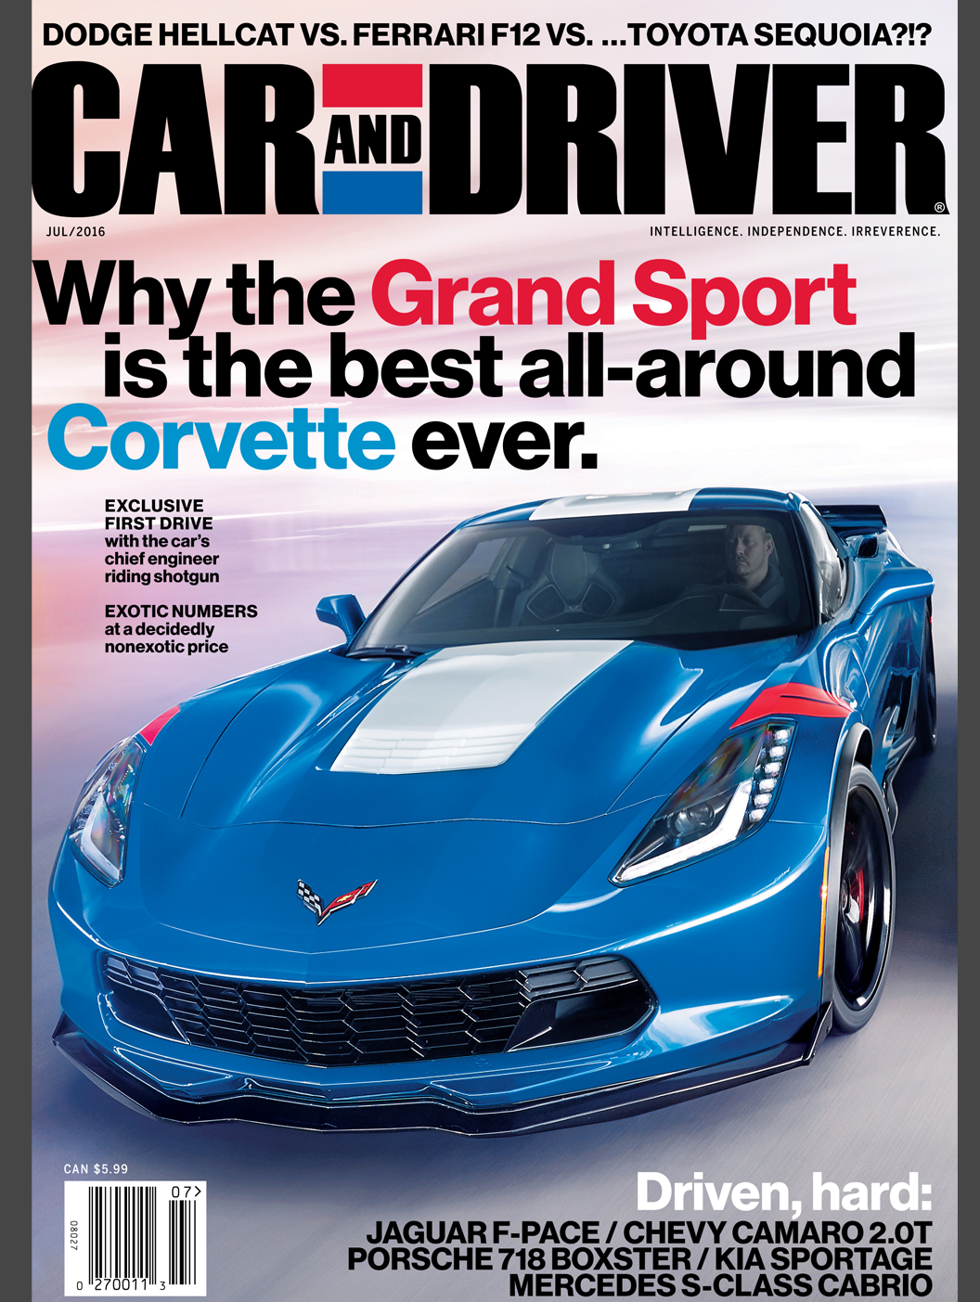
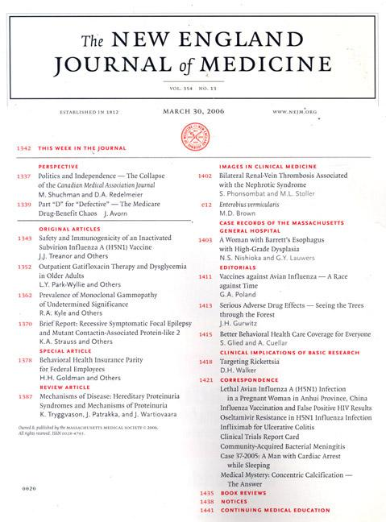
Error Correction - Topic Models
Notes:
. By detecting the semantic context of OCRed documents, our algorithm can use topic-specific word frequency information to correct corrupted words.
While there has been much focus on improving the accuracy of OCR by incorporating language models to guide error detection and correction, these models are typically global and treat each document equivalently,
even though vocabulary usage varies between documents.
For example, the distribution of words in Car & Driver differs from the distribution of words in the New England Journal of Medicine.
Because these two publications use jargons derived from separate domains, using word frequencies observed in one periodical to correct OCR results from the other could be disastrous.

Slide 9
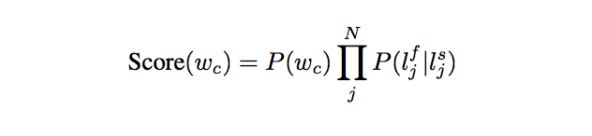

OCR Model and probability of candidate word
Example:
Boat → coat, bolt, beat
Score (wc) = probability that this word is a good replacement calculated by the multiplication of the probability that the word is located in each topic multiplied by the probability that you are on that topic multiplied by the probability of typical errors
P(wc) is the probability of the word
N is the number of letters in the word
and P(l f j |l s j ) is the probability that letter l s j was mistaken for l f j .
For example: boat → coat, bolt, beat
Proba that word is in each topic multiplied by the proba that you are on that topic multiplied by the probability of typical errors
Notes:
For each incorrect word wi in the document, we generate a list of all strings that differ from wi by zero, one, or two characters.
Due to the combinatorial explosion of this method, we do not consider words that are three or more characters apart from the original string.
For each word wc in this candidate list, we assign a score based on the particular model that is used and the letters that are flipped. For the simple global frequency approach, this combines the OCR model and the probability
READ SLIDE NOW
The idea is that:
So let’s assume boat is NOT a real word, let’s assume it’s a mistake
if the topic is clothing, or fashion or sometning similar, there is a higher probability that it will choose the word COAT as the correction

Slide 10
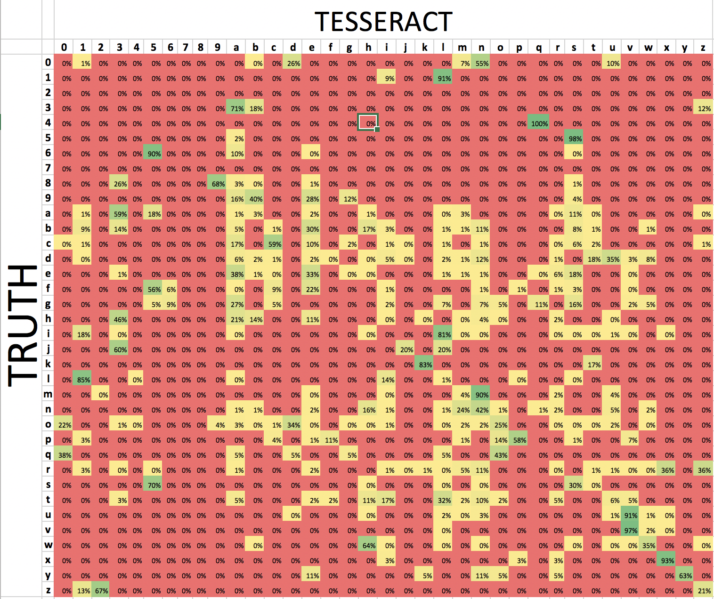
Notes:
Typical errors by LETTER calculated by looking at each line and Each word
P(l f j |l s j ) is the probability that letter l s j was mistaken for l f j .
Rows are ground truth
Given an 1 in ground truth, there is a 91% chance that l is the mistake
Given a 5 in ground truth, there is a 95% chance that S is the mistake
Go on and on

Slide 11
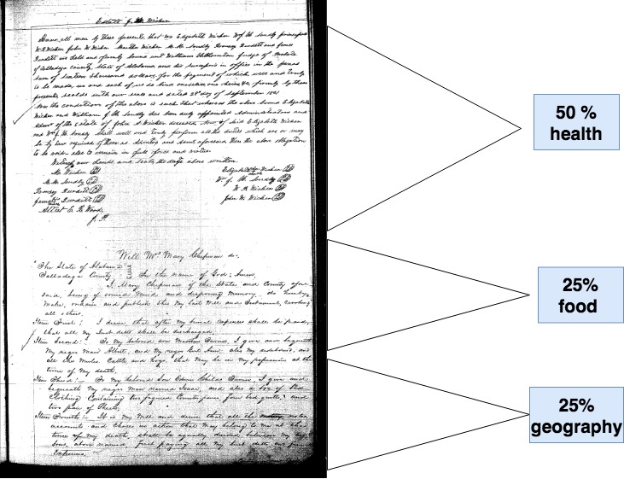
Pt_k
Notes:
the probability that you are on that topic

Slide 12
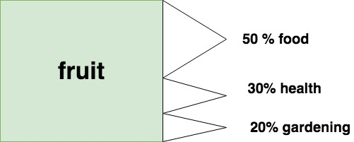
P(w|tk)
Notes:
probability that the word is located in each topic
I should note that This is not necessarily equal to 1,

Slide 13
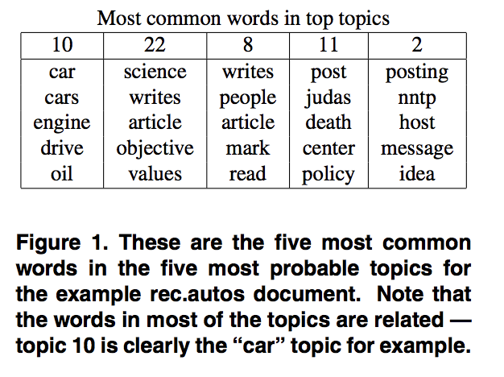
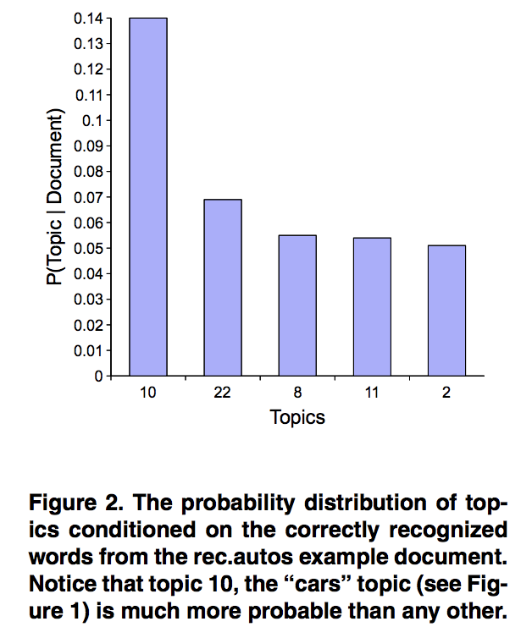
Notes:
Example from a document that our paper mentioned
you have 30 topics and the most common words in the 5 top topics
and then probability of topic given document
plotted with topics

Slide 14
Truth | Tesseract | Processed Tesseract
exhibit | exhlblt | exhibit
driver | drlver | driver
William | Wllllam | william
in | 1n | an
Indicated | 1nd1cated | indicated
Notes:
Now, we ran processing of Tesseract
This is a list of the comparison of the first couple words that show up
you can see 1 and i

Slide 15
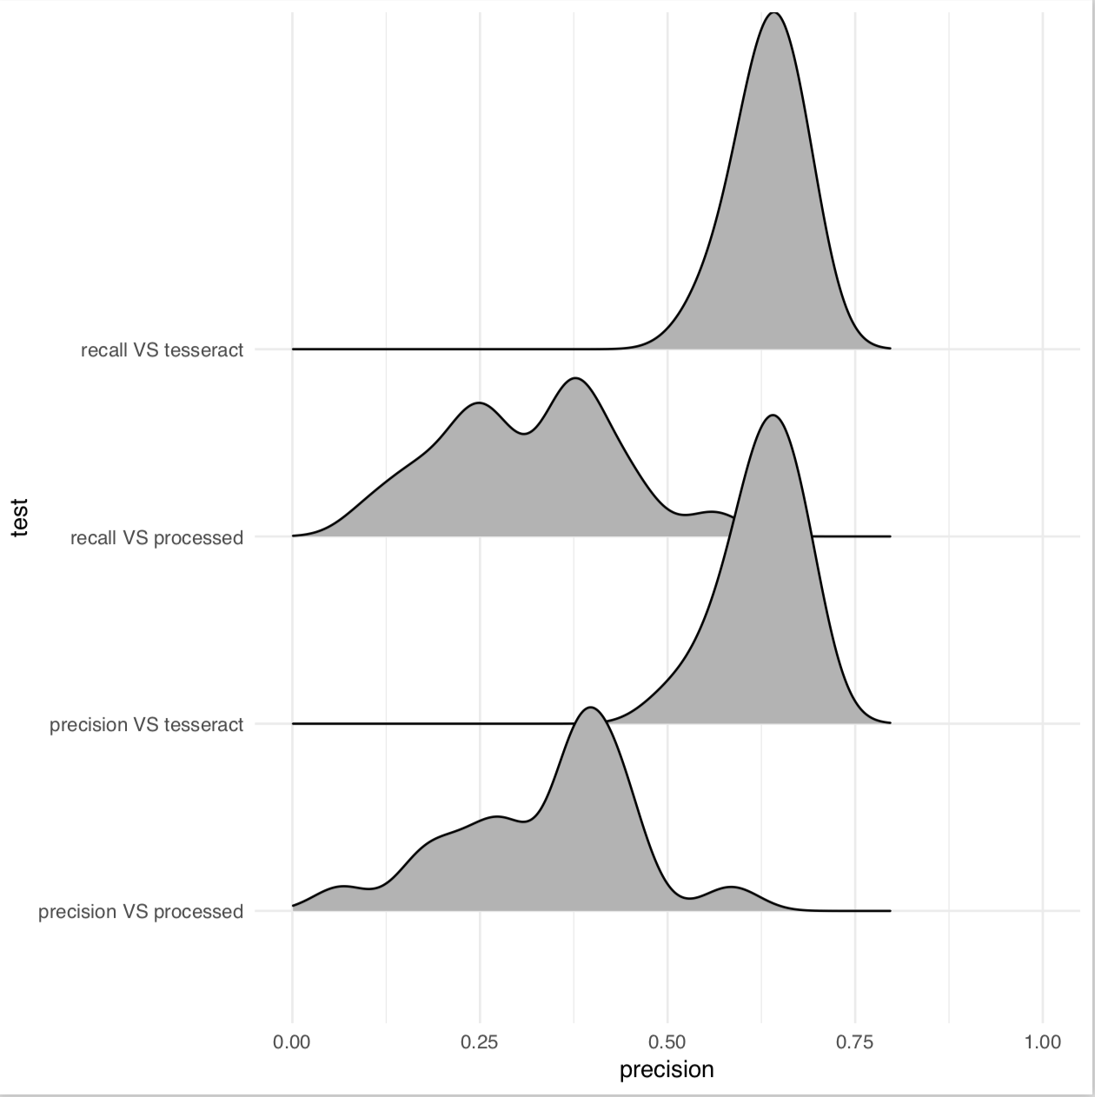
Precision and Recall for Word Separation
Tesseract_recall: 0.633
Tesseract_precision : 0.63
Processed_Tesseract recall: 0.31
Processed_Tesseract precision: 0.34
Notes:
the reason that recall/precision are lower after processed is:
over correction: we correct words that didn't need to be corrected

Slide 16
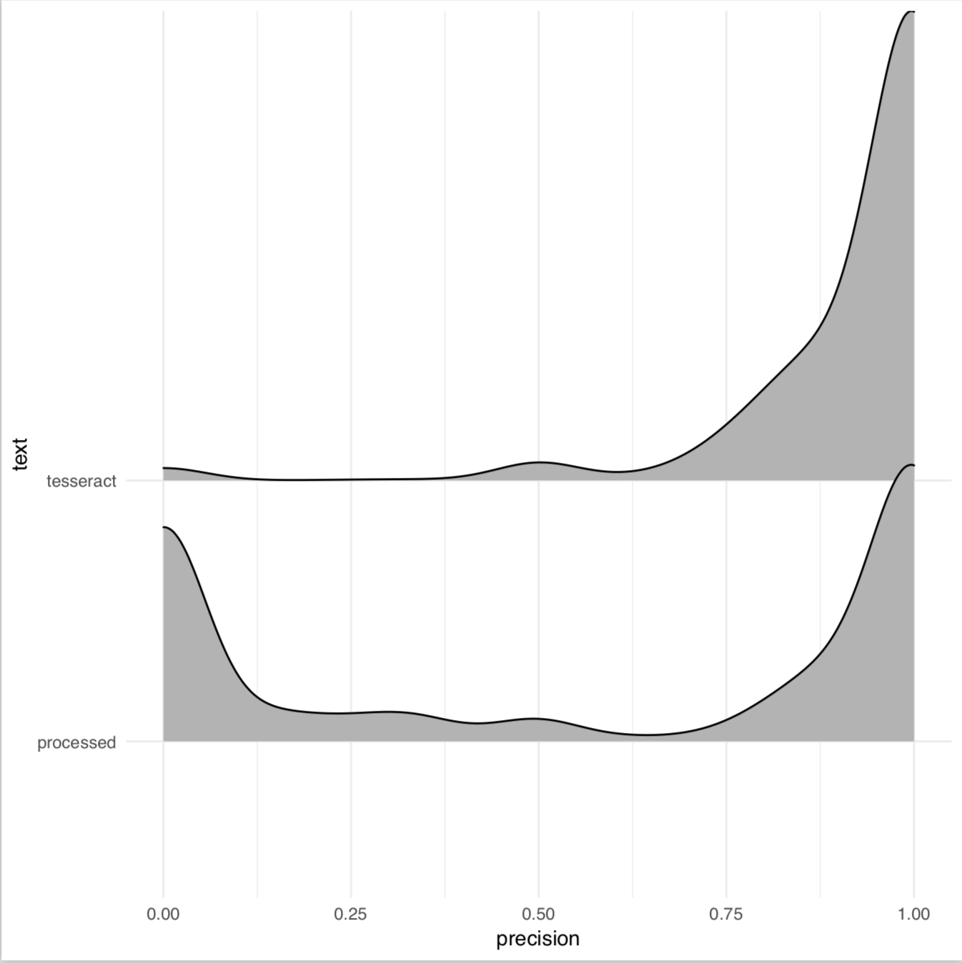
Precision and Recall
For character separation
Tesseract_mean = 0.82
Processed_mean = 0.56
Notes:
Only looked at comparisons with lines of same length and words of same length
t
we struggled matching words which is why our precision is bad at times
the mismatches occured because of introduced words, spaces, or words separated by tessaract

Slide 17
Improvements
Topic modeling by line instead of by document
Cross validation
Iterative contextual modeling
External dictionary
Dynamic matching using network modeling

